Slide 1
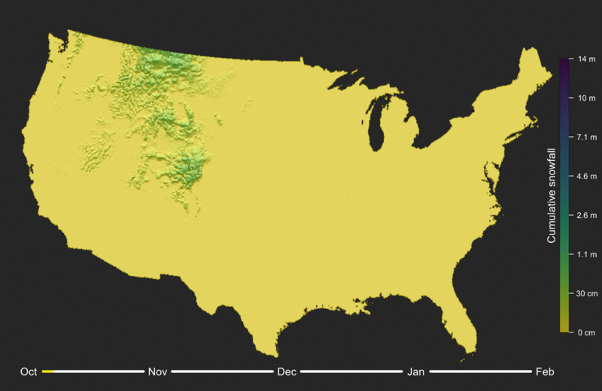
Notes:
http://strimas.com/r/snowfall/

Slide 2
Plan for this week
Tuesday:
Focal Operations
Thursday:
Focal Operations (Cont.)
Slope
Aspect

Slide 3


Slide 4
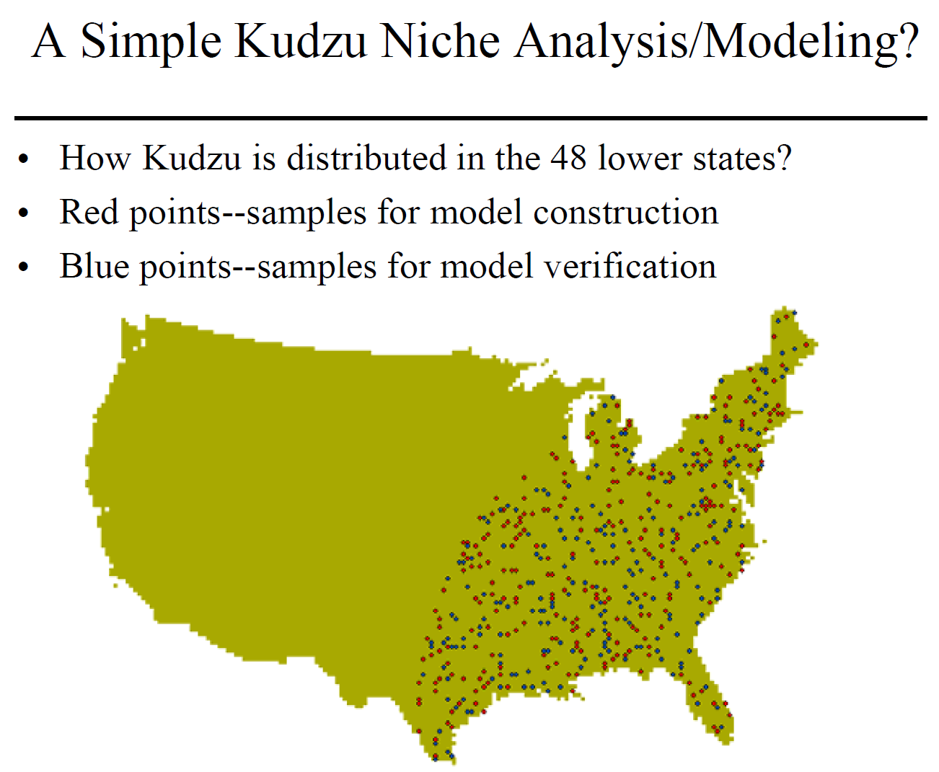

Slide 5
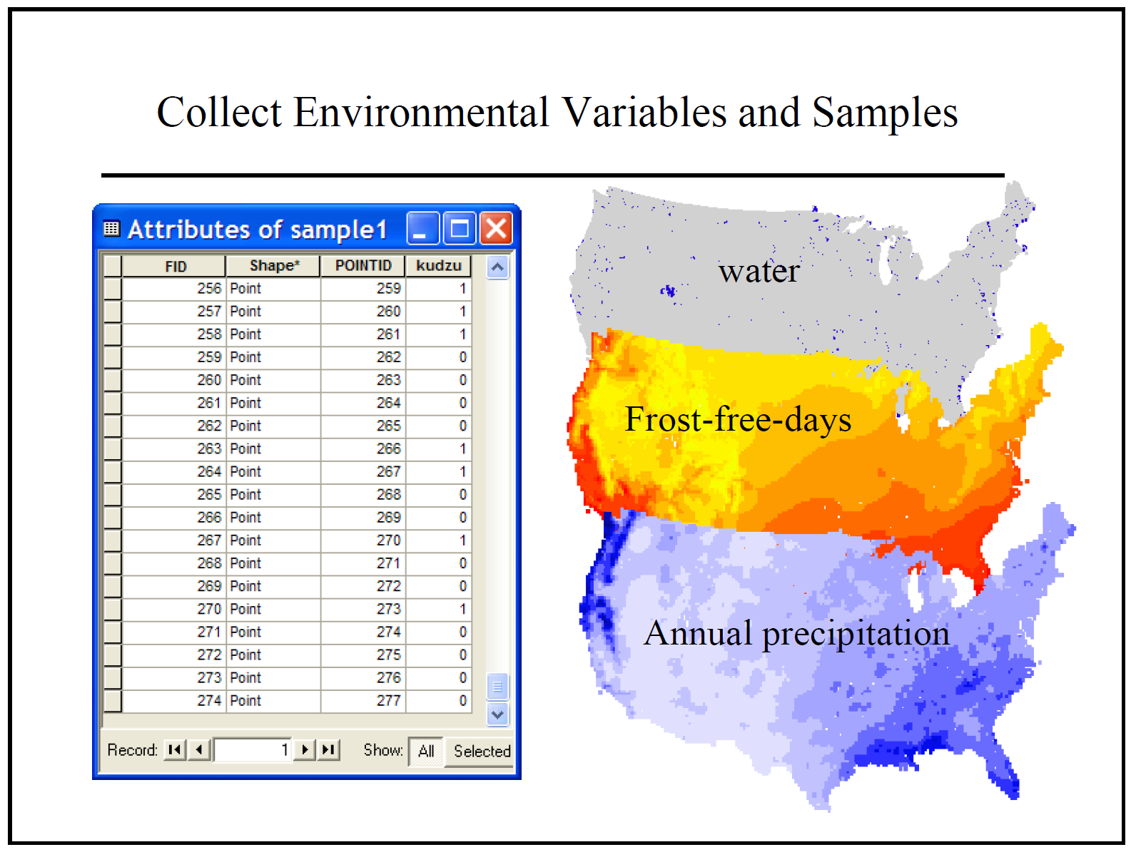

Slide 6
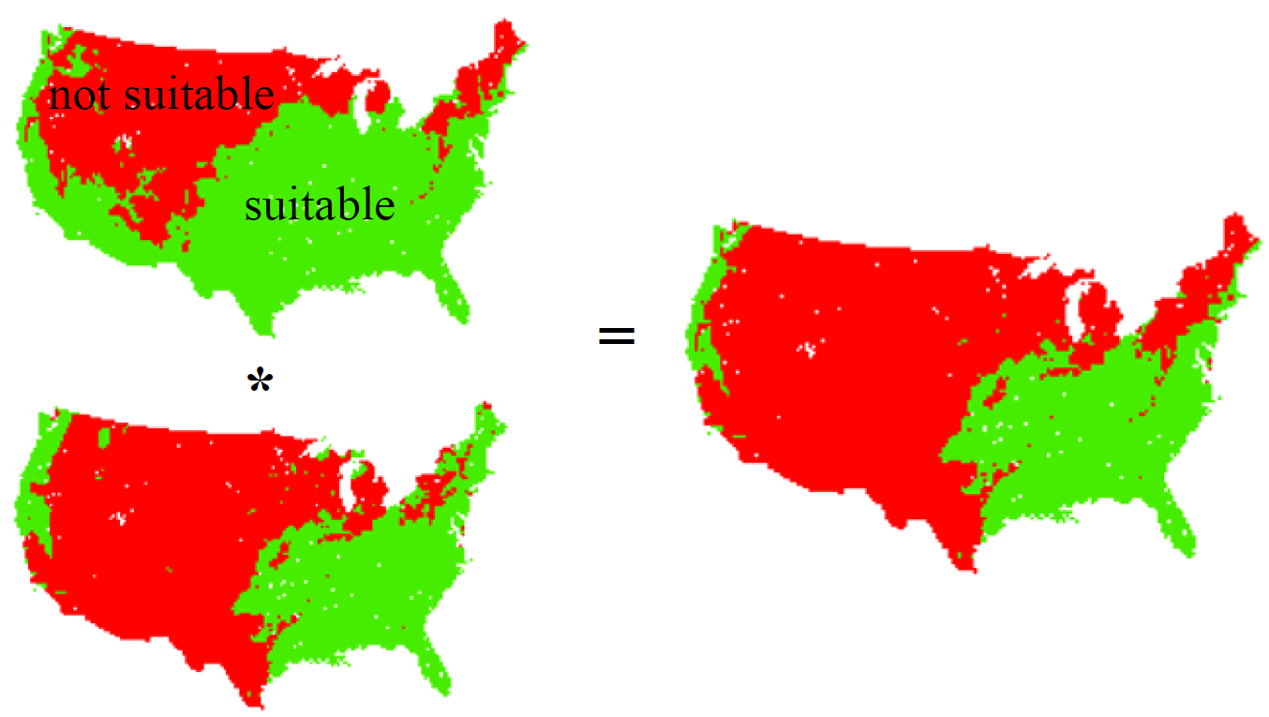

Slide 7
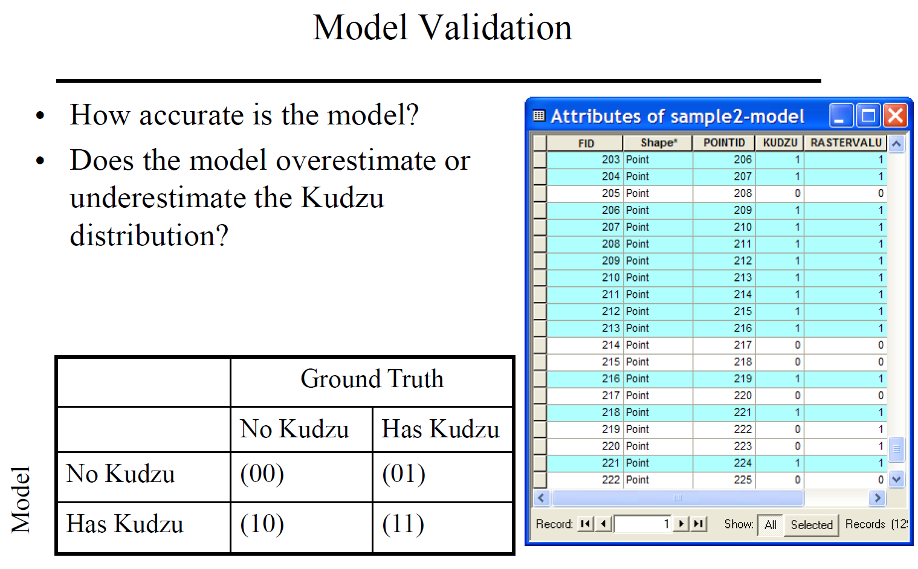

Slide 8
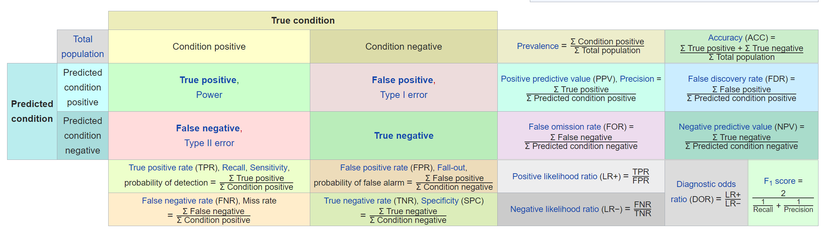

Slide 9
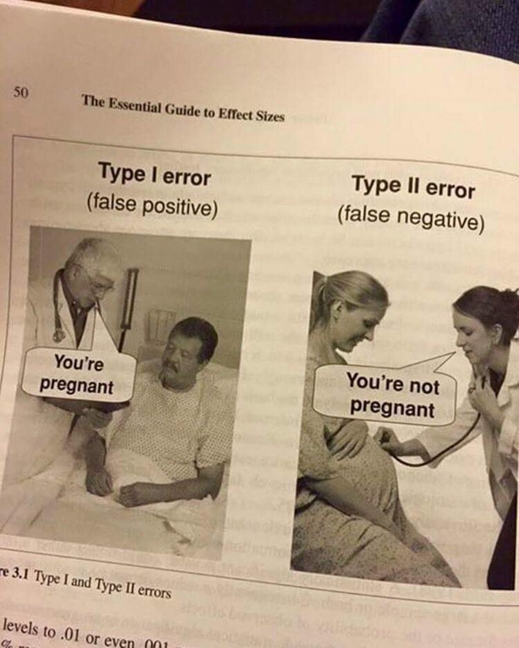

Slide 10
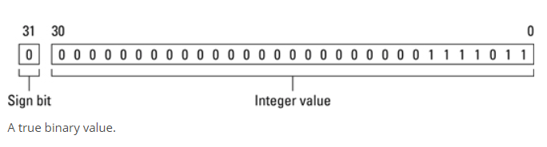
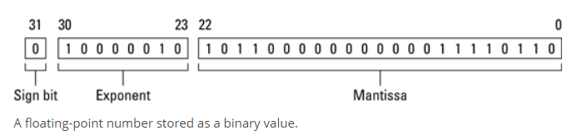
INT vs. Float

Slide 11
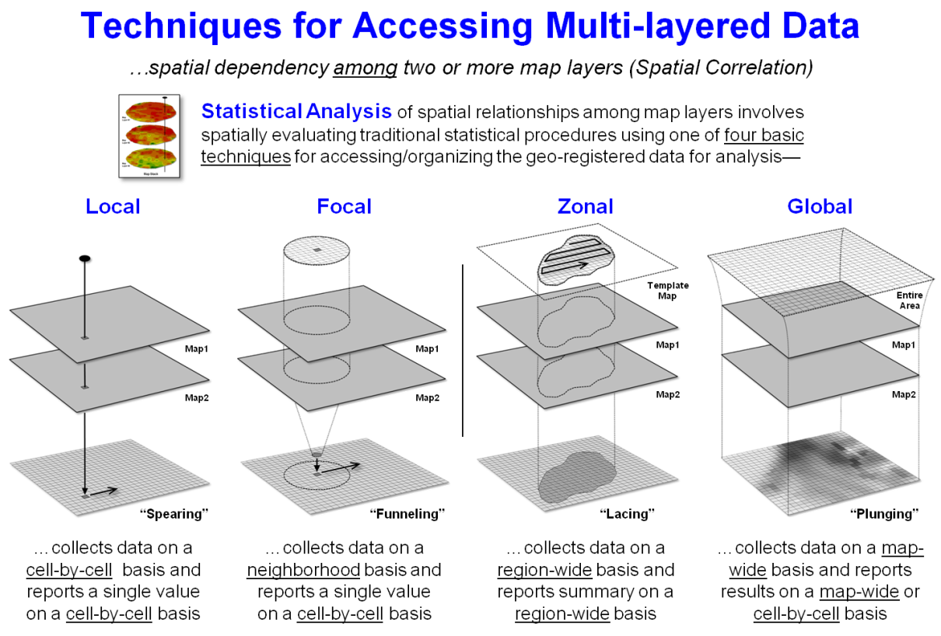
Local Operations

Slide 12
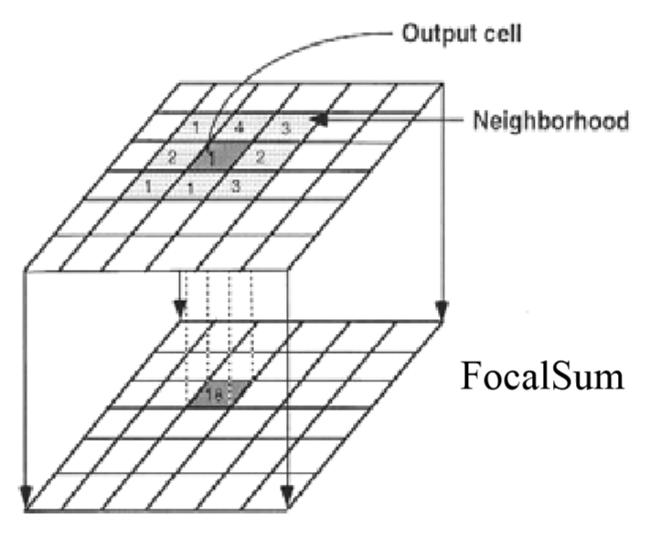
Focal Operations
Computes an output value for each cell as a function of cells that fall within the defined neighborhood
Widely used in image processing with different names
Convolution, filtering, kernel, moving window, focus
Focal operations are spatial in nature

Slide 13
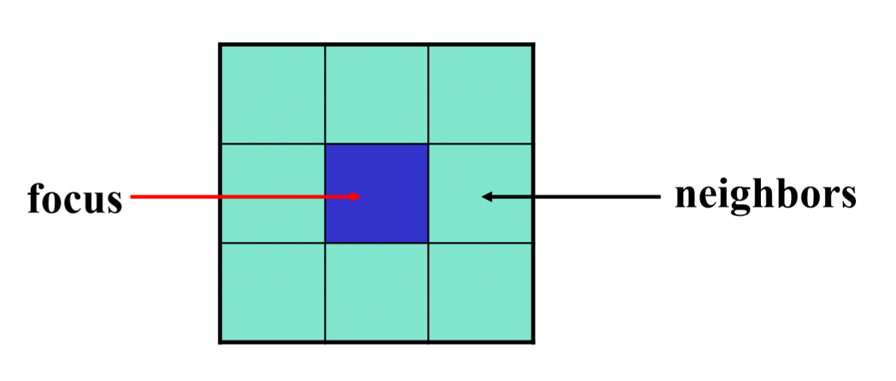
Focal Neighbors
The simplest and most common neighborhood is a 3x3 rectangular window
The center of the cell is referred to as the focus, the others are part of the neighborhood.

Slide 14
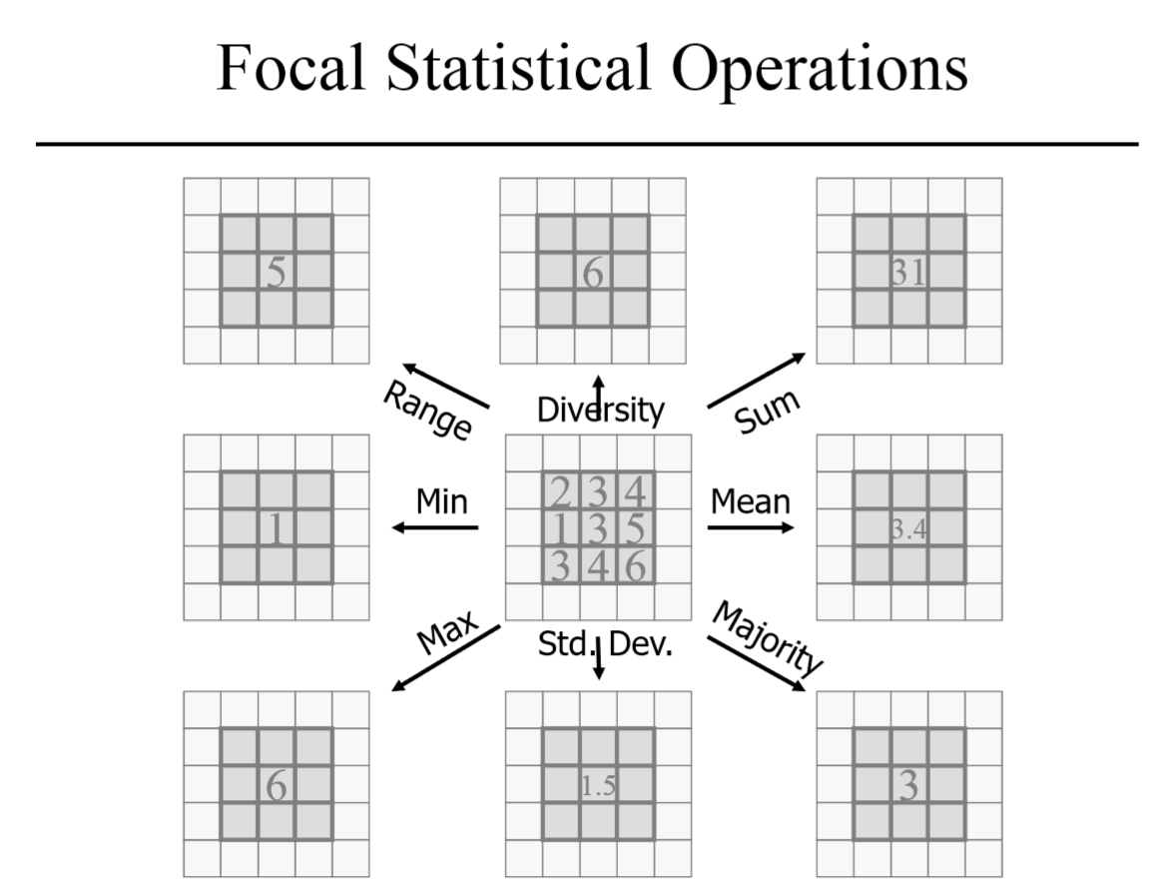

Slide 15
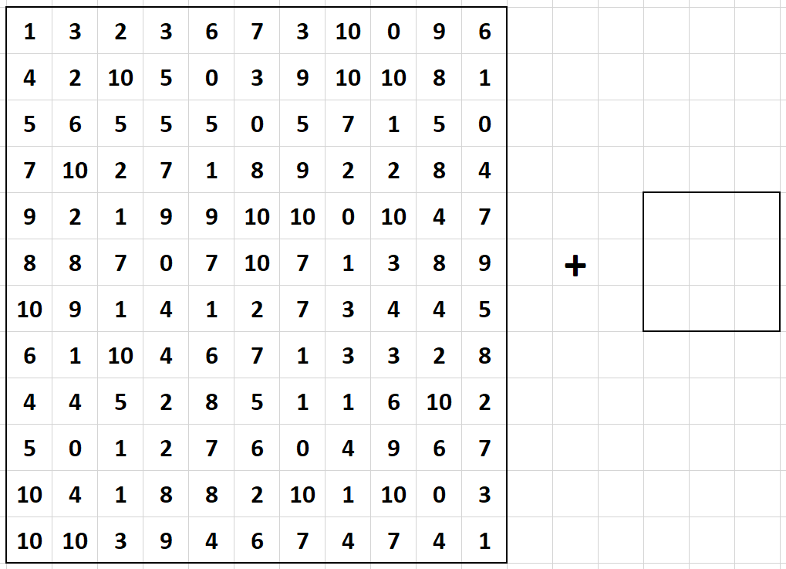

Slide 16
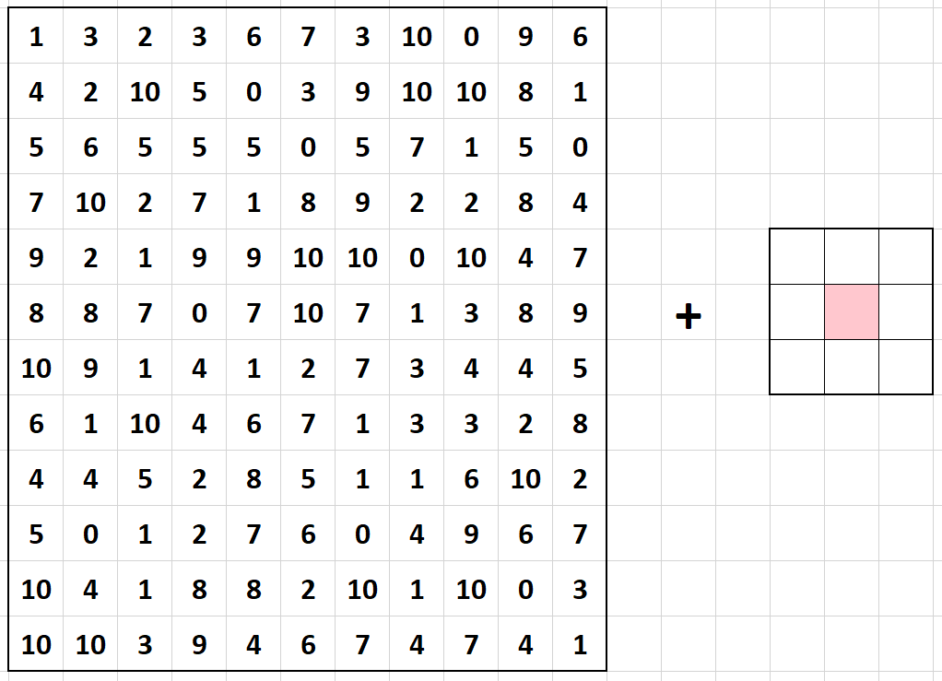

Slide 17
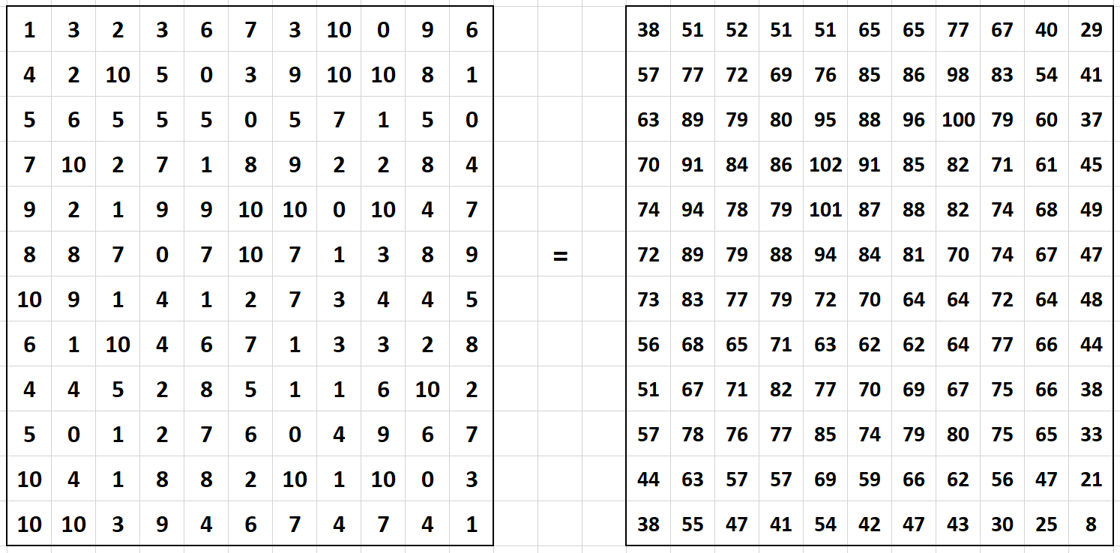

Slide 18
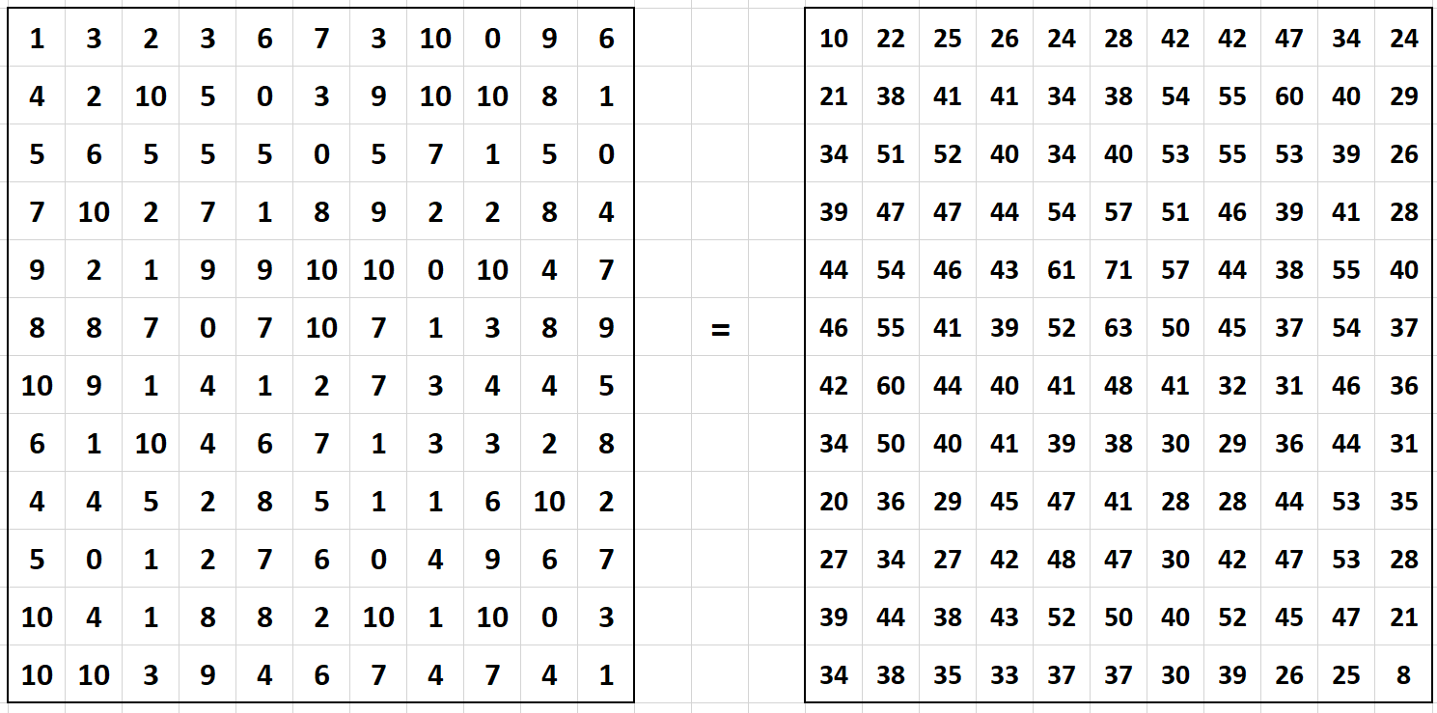
X=1+3+4+2

Slide 19
X=1+3+2+4+2+10

Slide 20
X=3+2+3+2+10+5

Slide 21
X=…

Slide 22
X=…

Slide 23
X=…

Slide 24
X=…

Slide 25
X=…

Slide 26
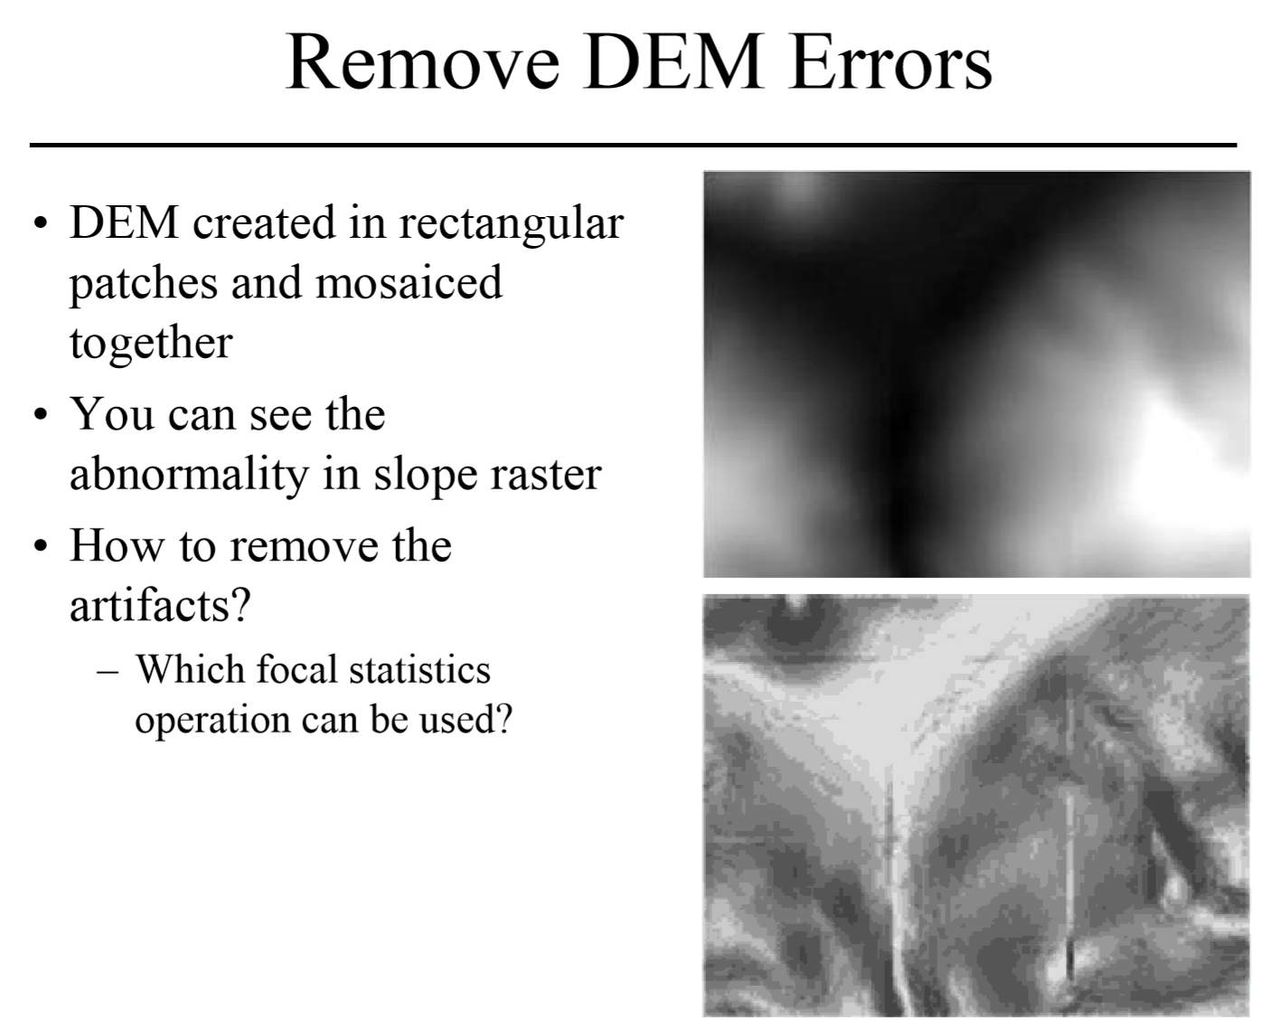

Slide 27
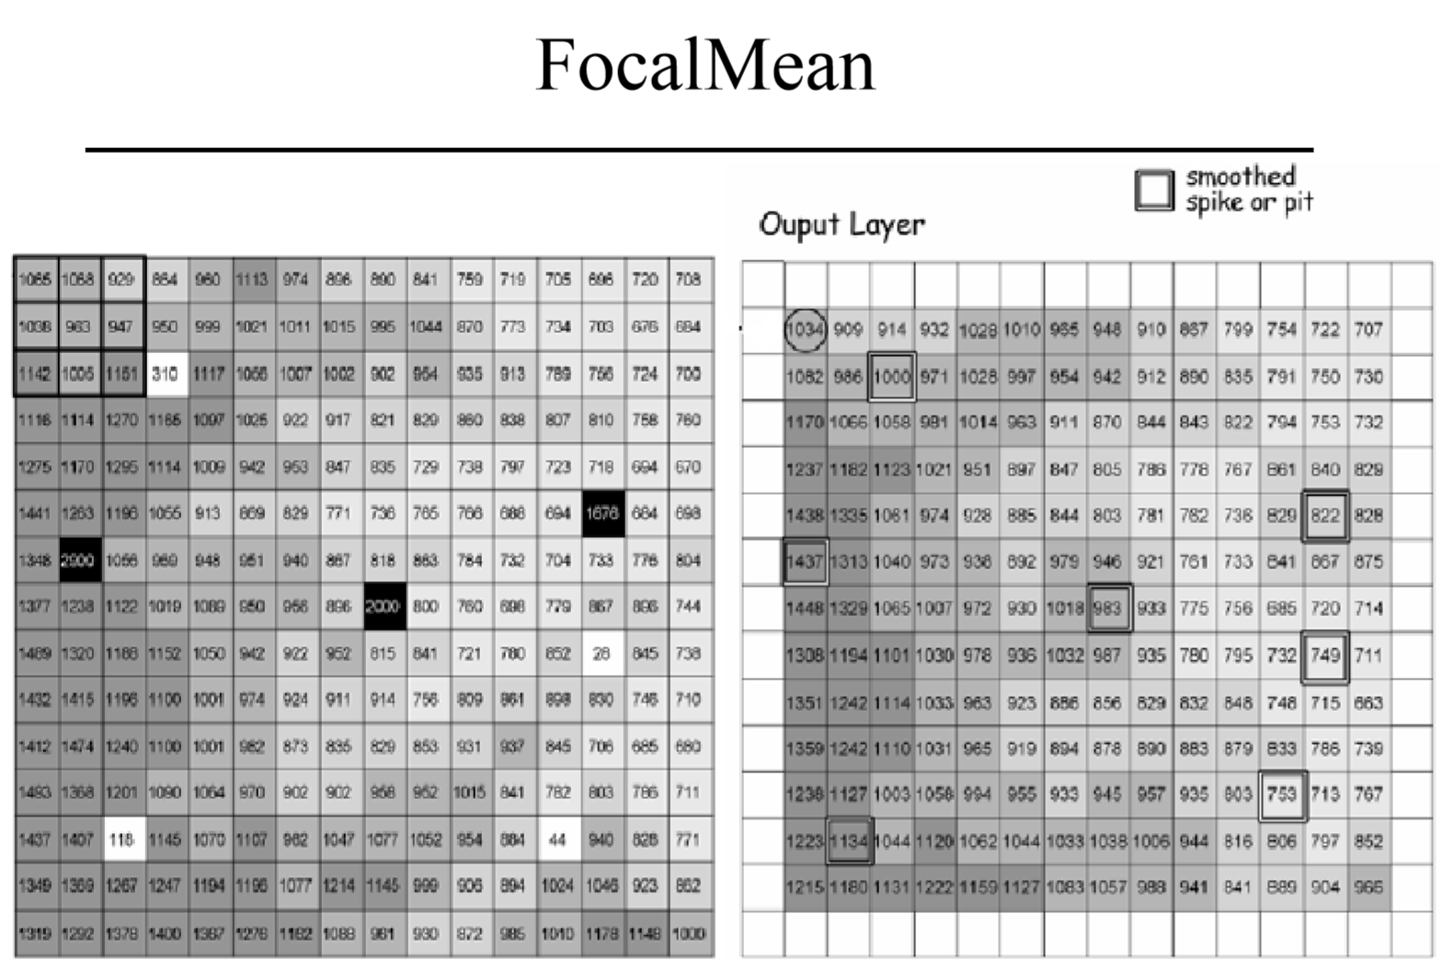

Slide 28
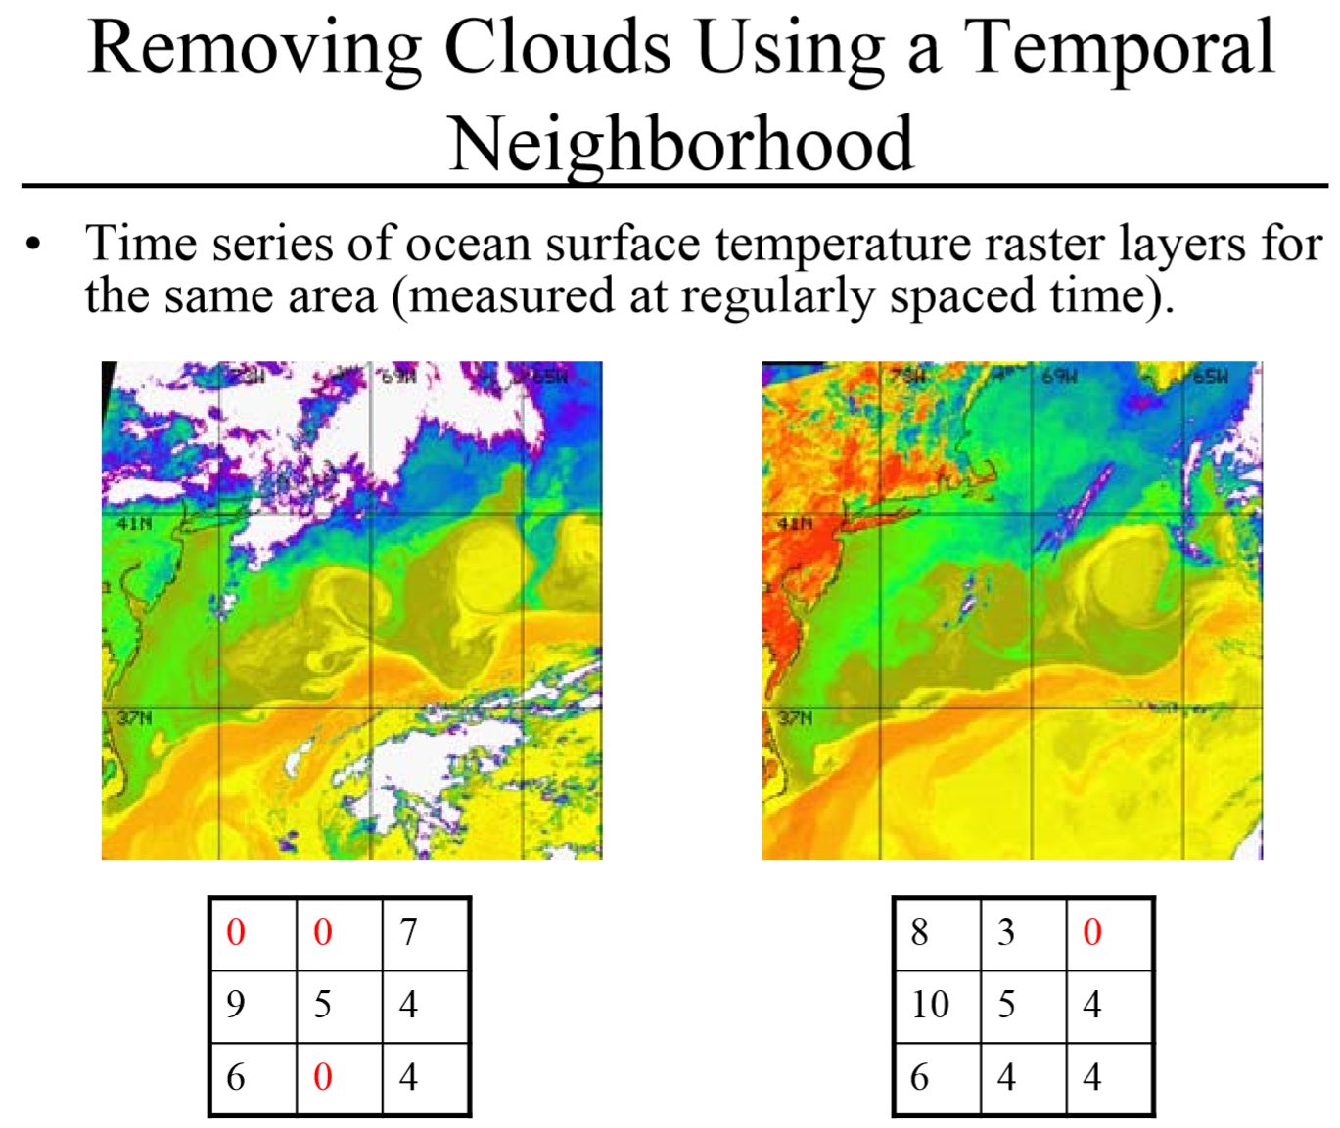

Slide 29
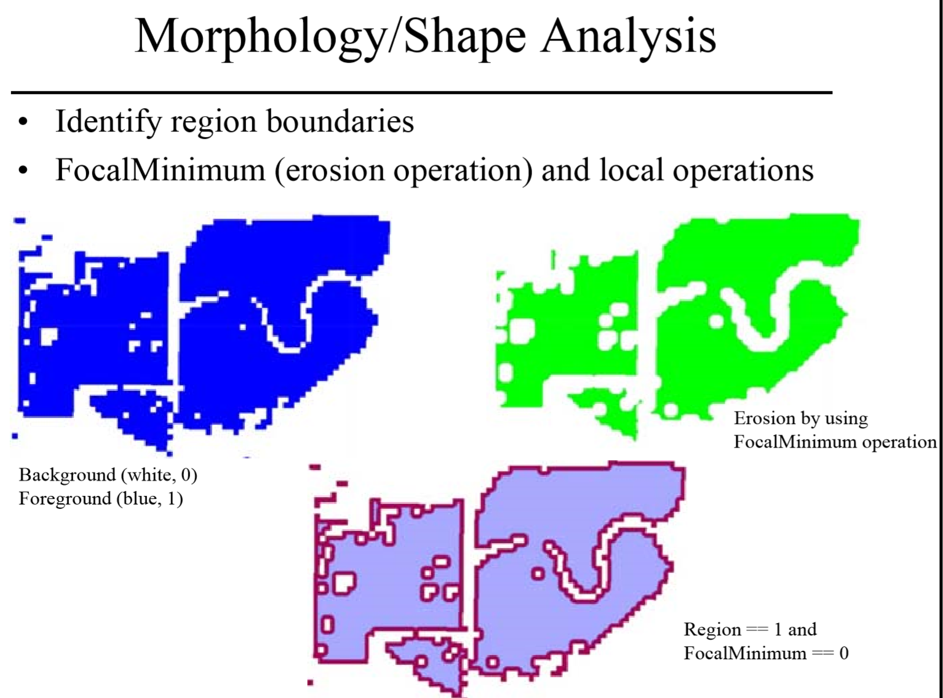

Slide 30
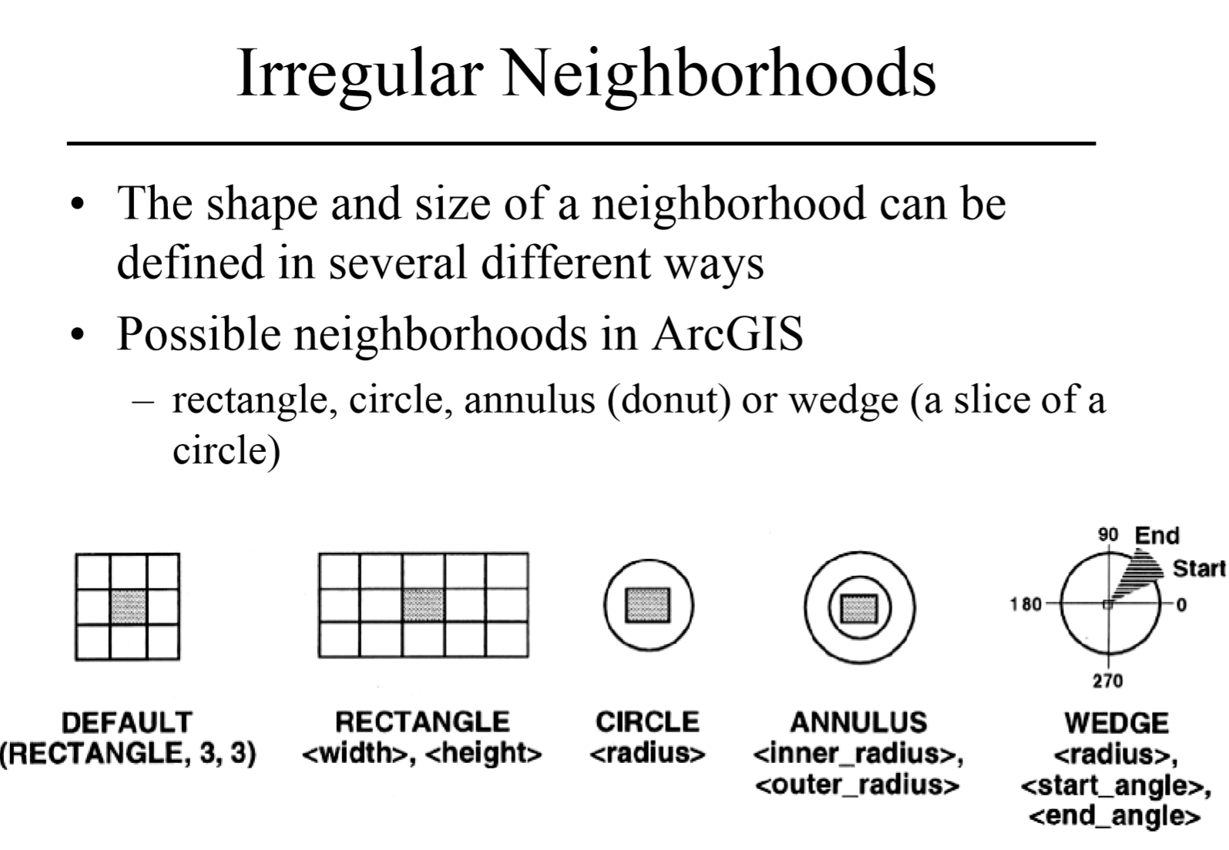

Slide 31
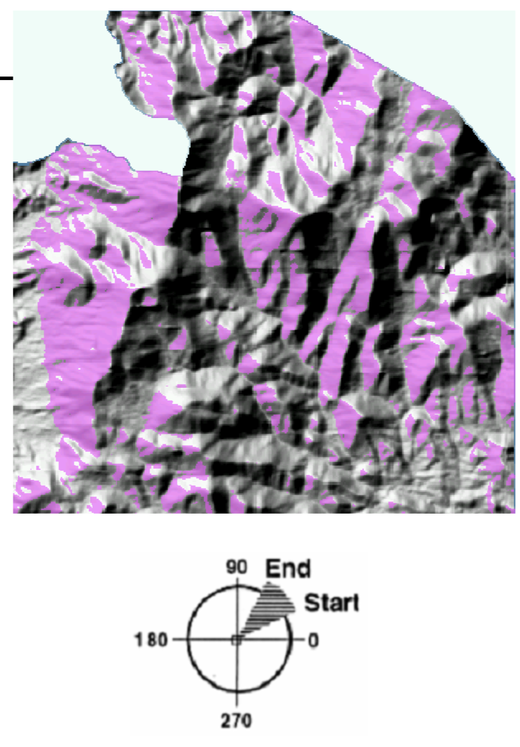
Finding An appropriate Wind Farm Site?
Conditions:
Wind speed
Higher elevations have higher winds
Elevation > 1000 meters
Aspect
Face the prevailing wind direction
Exposure
Not blocked by nearby hills
Aligned with the prevailing wind direction
Given
Prevailing winds
225⁰ to 315º with a north 0, clockwise rotation
DEM
Caution!!!
Know your tools, wedge is defined as 0 east, counterclockwise!!!
(135 – 225)!!!!

Slide 32
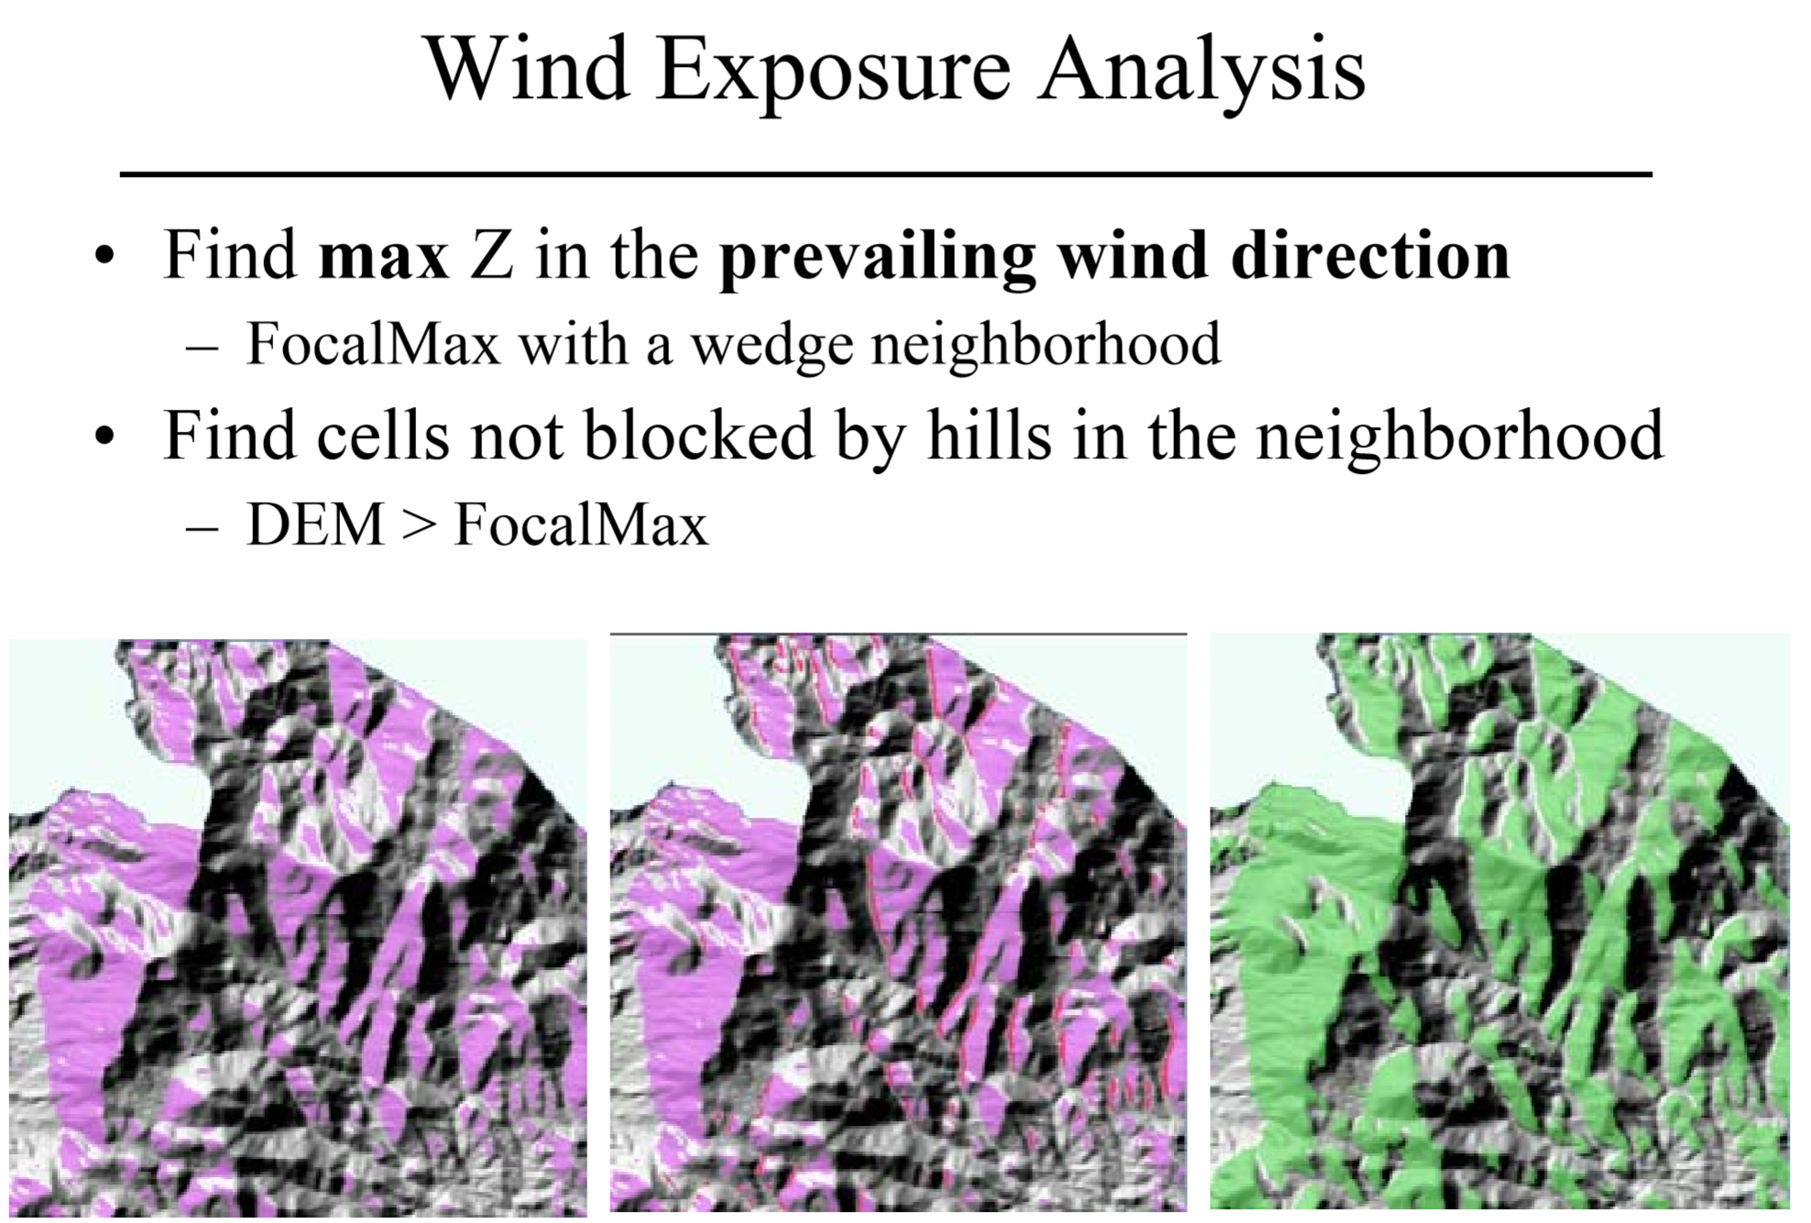

Slide 33
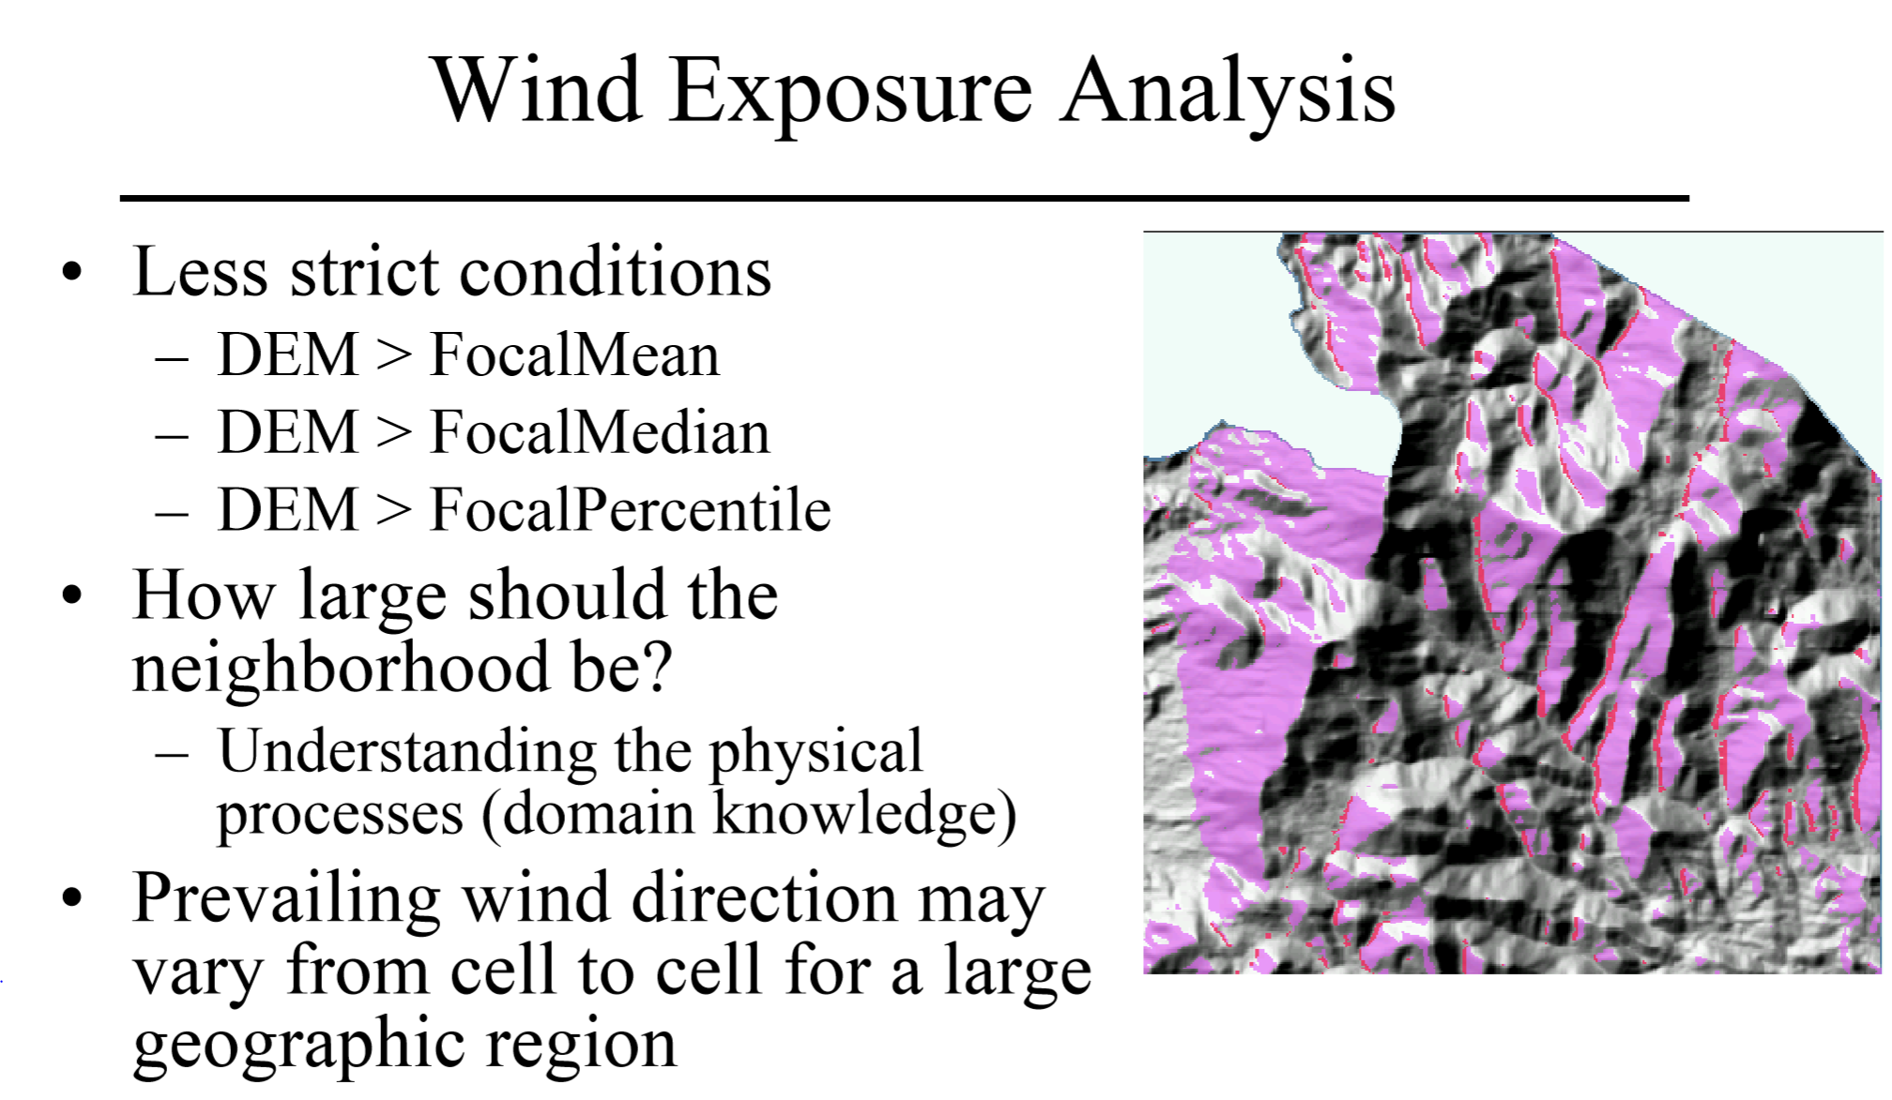

Slide 34
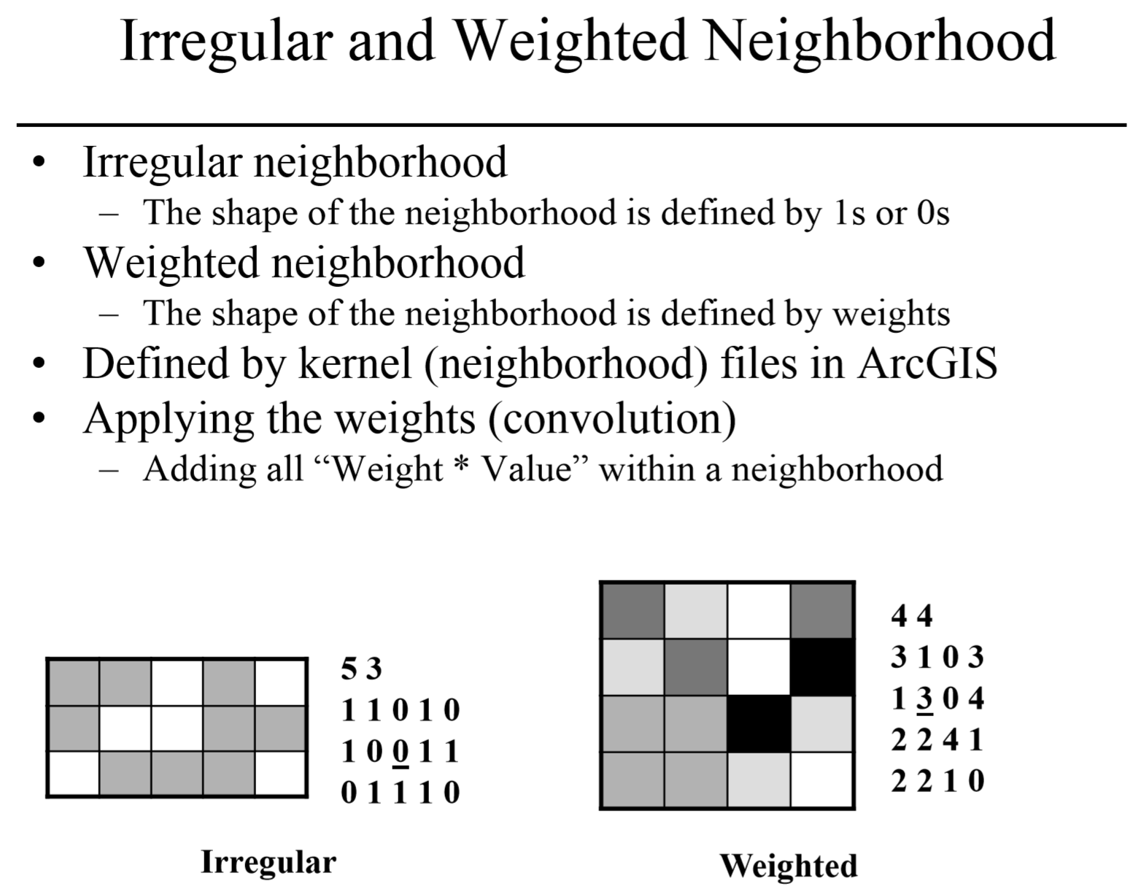

Slide 35
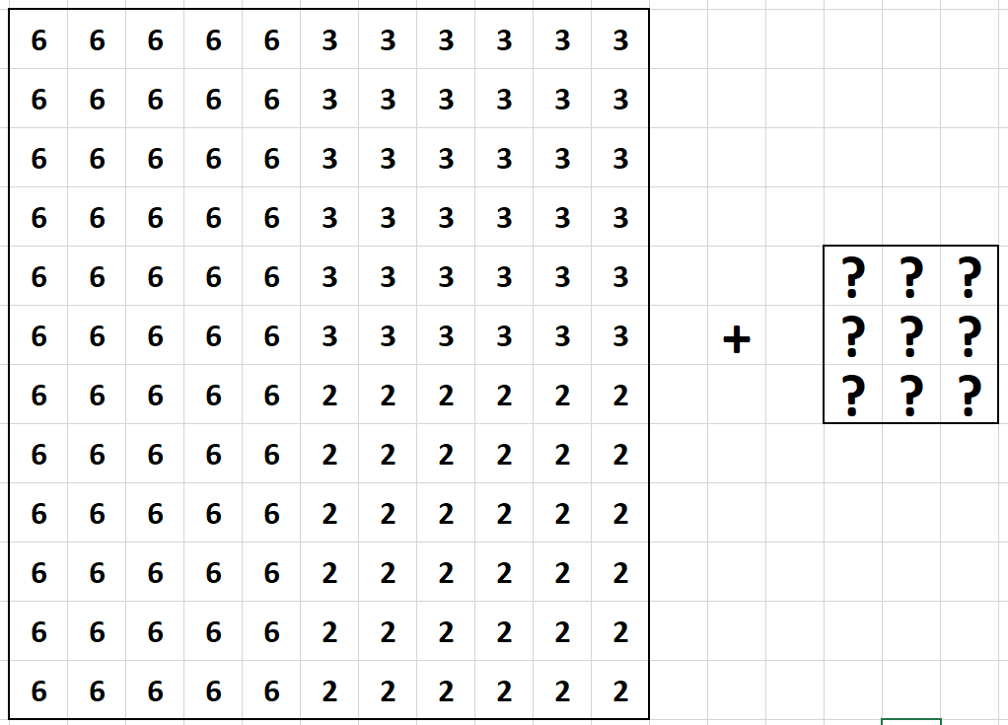
Edge detection

Slide 36
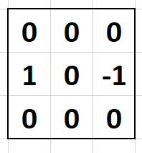
Edge detection: Vertical

Slide 37
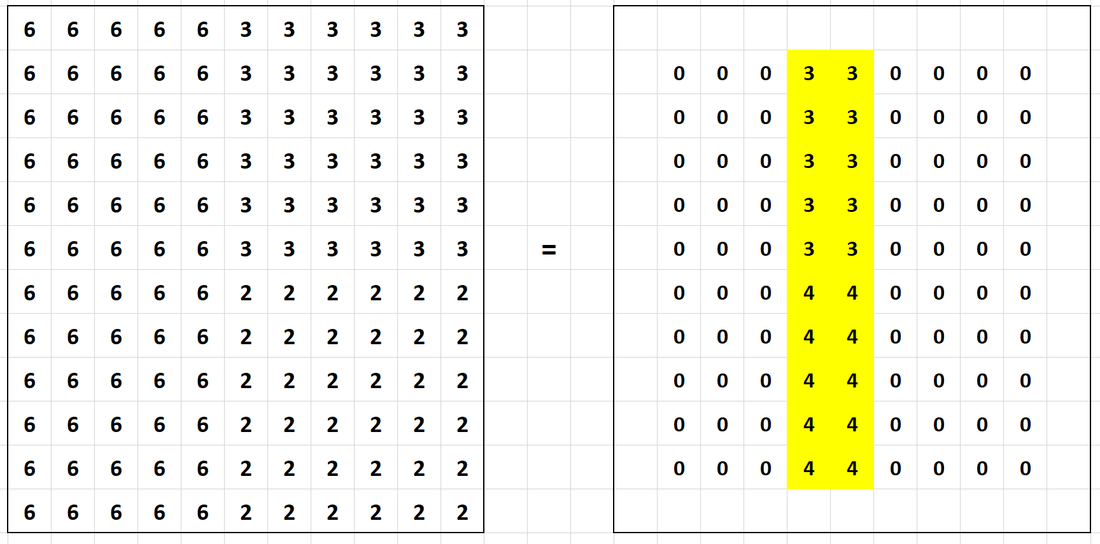

Slide 38
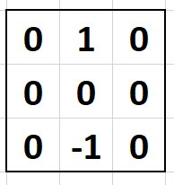
Edge detection: Horozontal

Slide 39
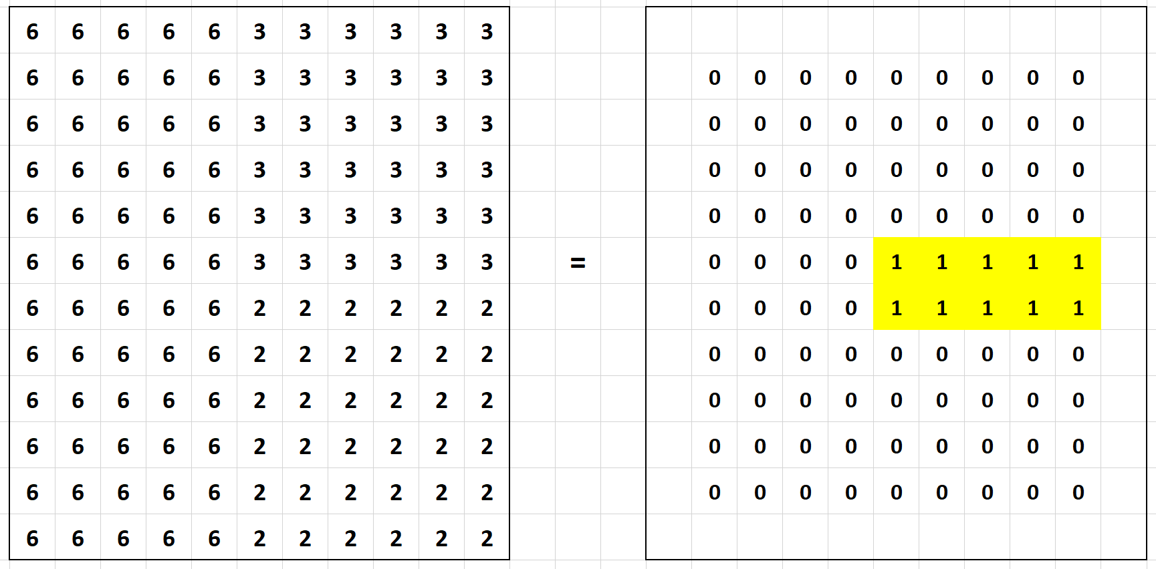

Slide 40
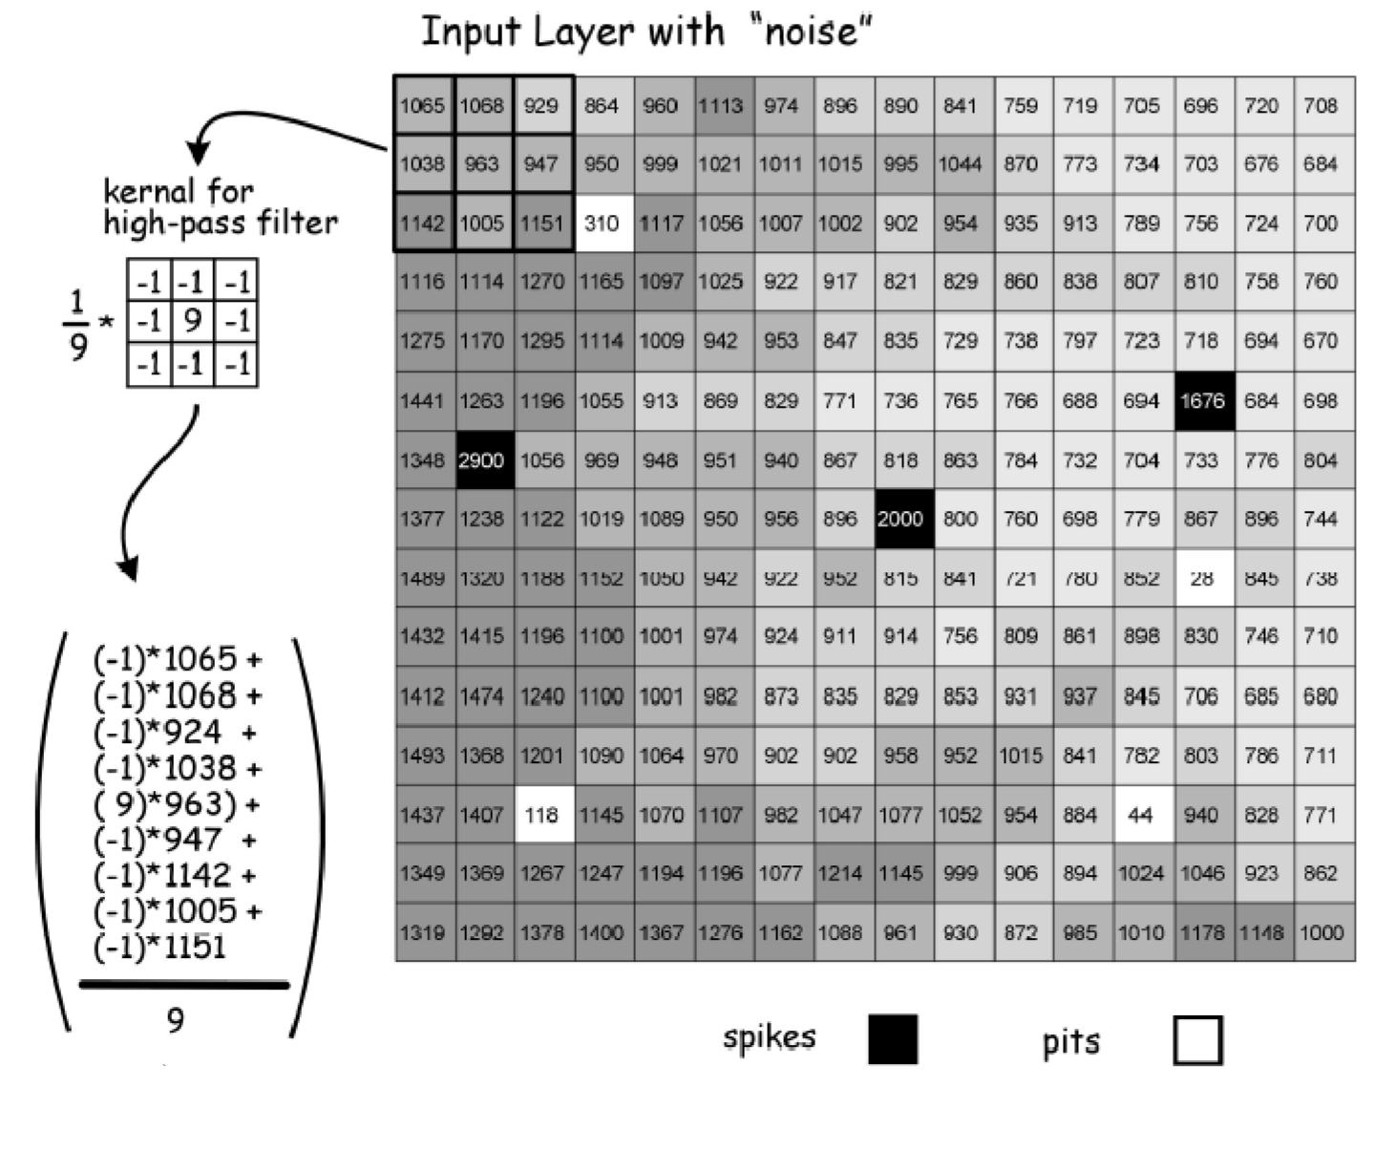
High-Pass Filter

Slide 41
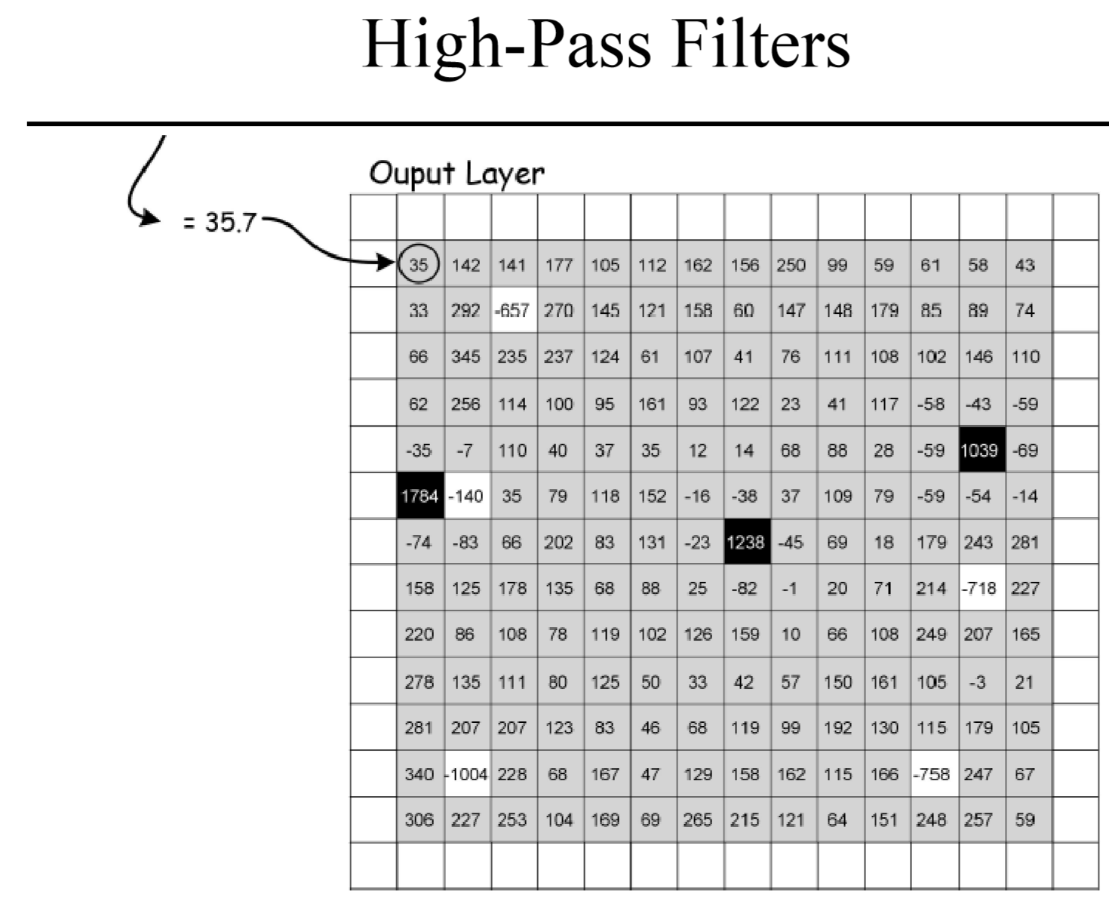

Slide 42
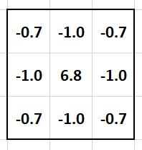
HIGH-Pass Filter
Small values with smoothly changing values within a neighborhood
Large positive values when centered on a spike
Large negative values when centered on a pit
ArcGIS uses the following weights
Spatial Analyst toolbox > Neighborhood > Filter

Slide 43
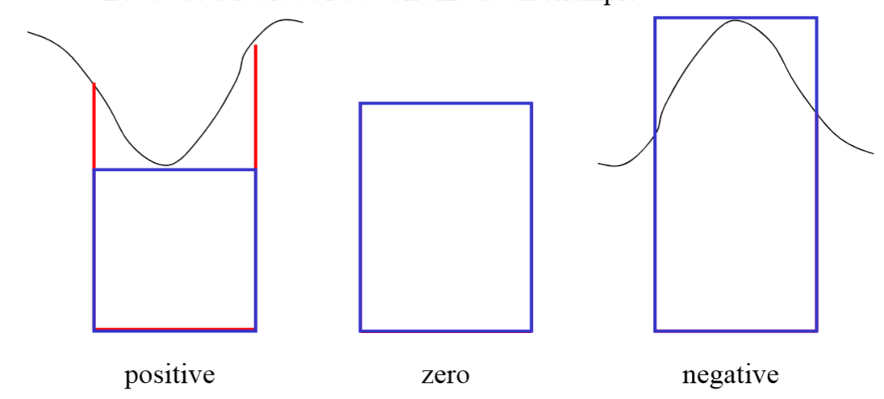
Shelter-ness analysis
Identify concavity (concave/convex) of the underlying terrain
Useful for geologic/archeologic applications
Measure the volume of a focal zone
Volume of the surface vs volume under a cylinder at focus hight
Positive, zero, negative values
Neighborhood radius is dictated by domain knowledge

Slide 44
Calculate shelter factor
Volume under the surface within the window
Assume a cell size of 10 and a circular feature size of 50
VolumePerCell = DEM * 10 * 10
VolumeUnderSurface = FocalSum(VolumePerCell, circle, 50)
Cylinder volume within the neighborhood
Calculate the number of cells in the circular neighborhood
Make a constant raster layer of 1
CellsInNeighborhood = FocalSum(Const1, circle, 50)
CylinderVolume =VolumePerCell * CellsInNeighborhood
Shelter Factor
ShelterFactor = VolumeUnderSurface - CylinderVolume

